Slide 1
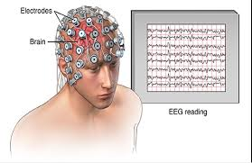
Electroencephalogram (EEG) Signal Analysis
Presented by:
Priyanka Aggarwal – B00123045
Vimal Jaswal - B00122875
Masters of Engineering in Internet of things technologies
TU Dublin, Blanchardstown, Ireland.

Slide 2
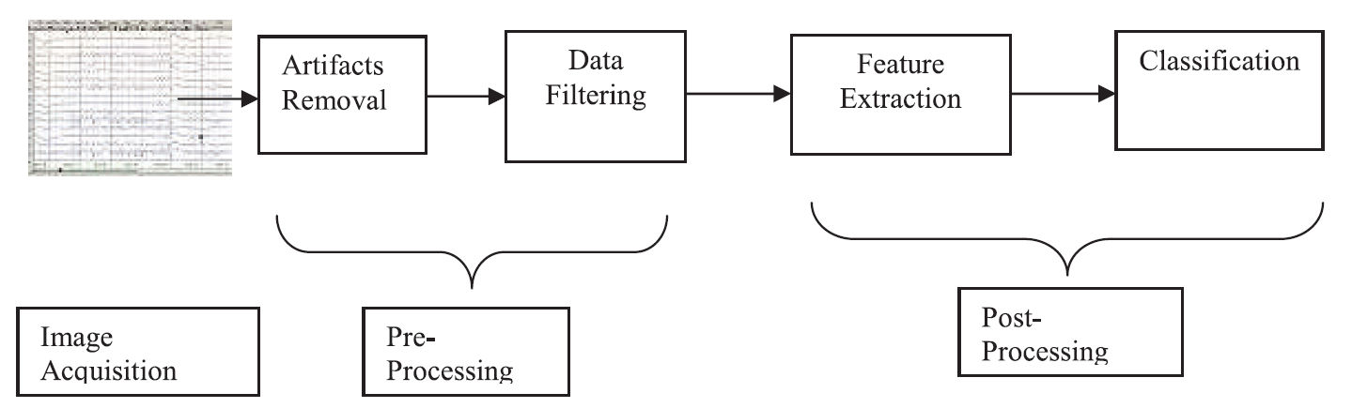
Introduction
Electroencephalography (EEG) is a monitoring method to record electrical activity of the brain by placing electrodes on scalp.
EEG analysis is beneficial for detecting brain disorders such as tumors, seizures, Alzheimer’s disease, epilepsy and other.

Slide 3
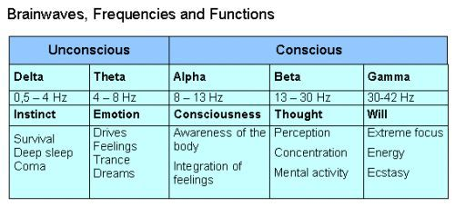
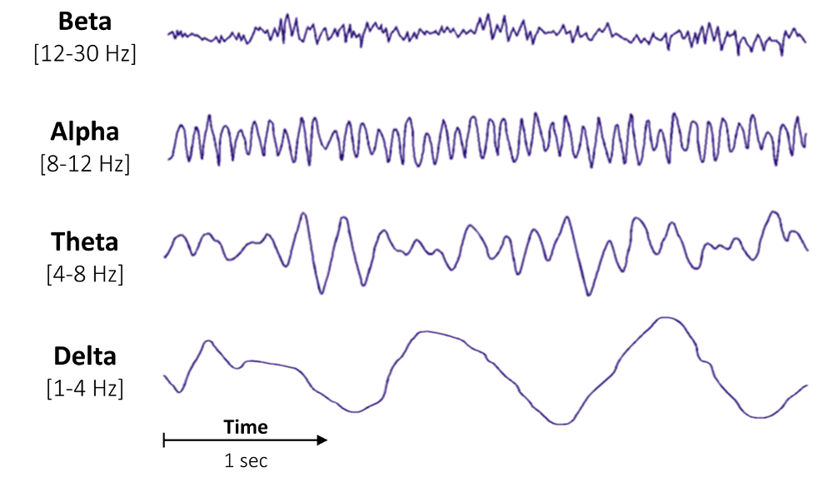
EEG Signals & its Characterizations

Slide 4
EEG Signal Noise Sources
Artefacts: The recorded activity which is not of cerebral origin.
Physiologic: Patient related artefacts (eyes, muscles)
Extra physiologic or External artifacts:
Technical artifacts (50/60 Hz artifact, cable movements, electrodes)
External, environmental sources of noise, AC power lines, lightening and array of electronic equipment (from computers, displays and TVs to wireless routers, mobile phones).

Slide 5
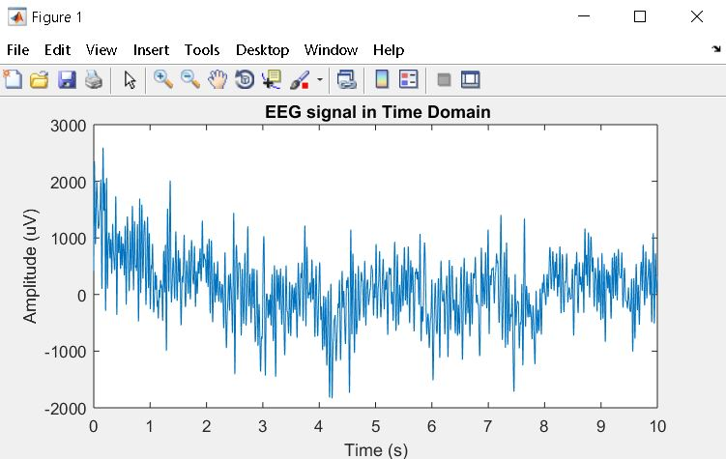
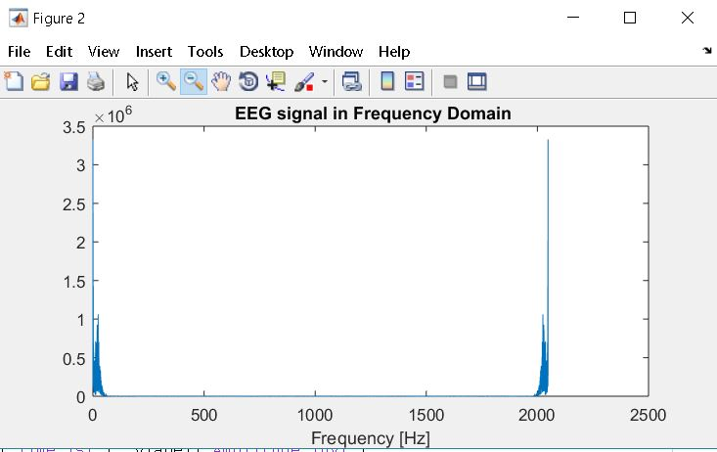
EEG Signal Plot Time and Frequency Domain
close all; clear all; clc; % Data taken from Physiobank RSVP tasks EEG P7 electrode
fs = 2048;% sampling frequency
T = 1/fs;
load ('C:\Users\vimal\Desktop\rsvp_10Hz_02a_edfm_P7');
N =length(val); % samples per second
t =[0:length(val)-1]/fs;% time for plot
f = fs*(0:N/2-1)/N; %freq data for plot
figure
plot(t,val);
xlabel('Time (s)'), ylabel('Amplitude (uV)'),
title(' EEG signal in Time Domain'); %EEG signal in time domain
%get fft to represent eeg signal in frequency domain
x_fft=fft(val);
step = fs/(length(x_fft)-1)
freq = 0:step:fs;
figure
plot(freq, abs(x_fft))
xlabel('Frequency [Hz]'), title(' EEG signal in Frequency Domain');

Slide 6
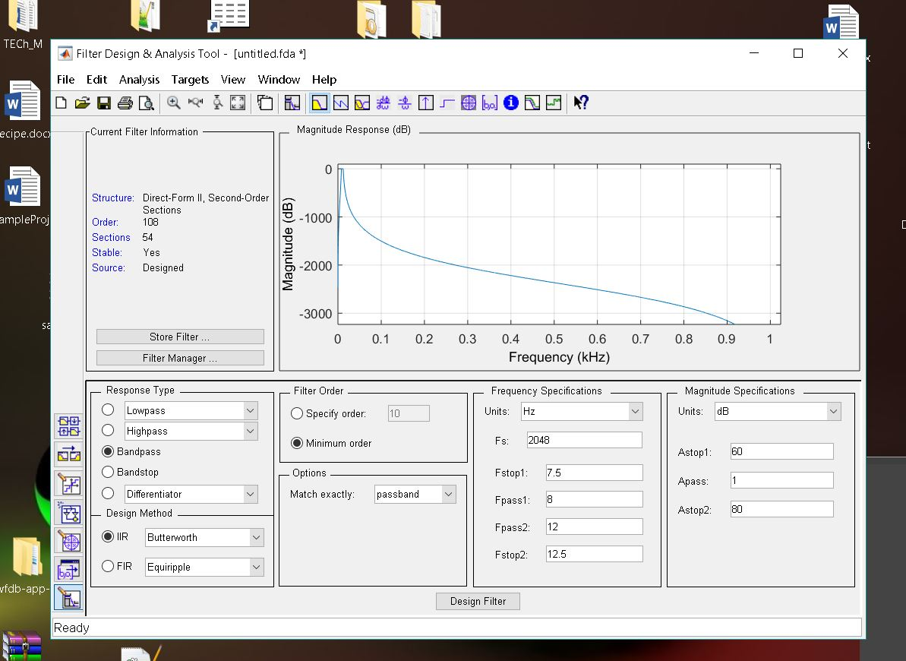
EEG Filter Design for Waves Classification

Slide 7
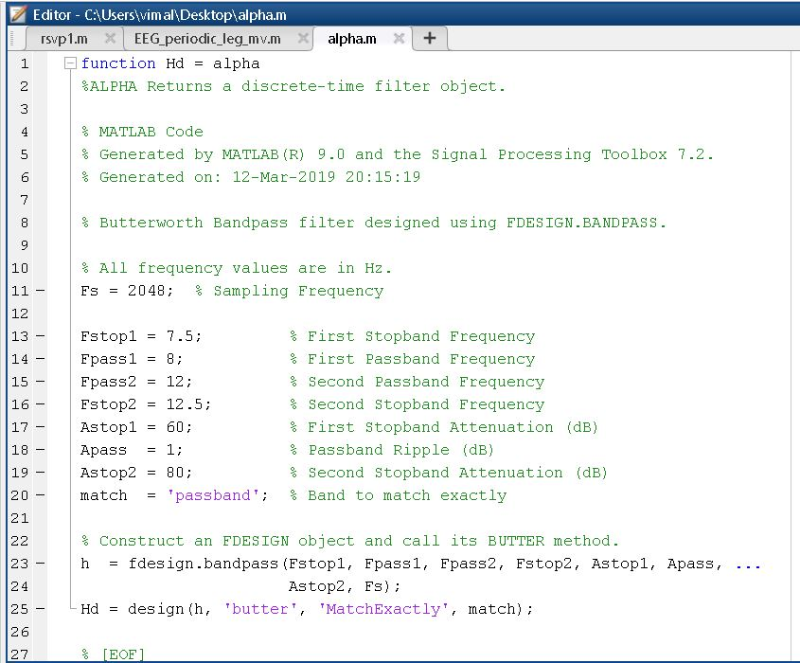
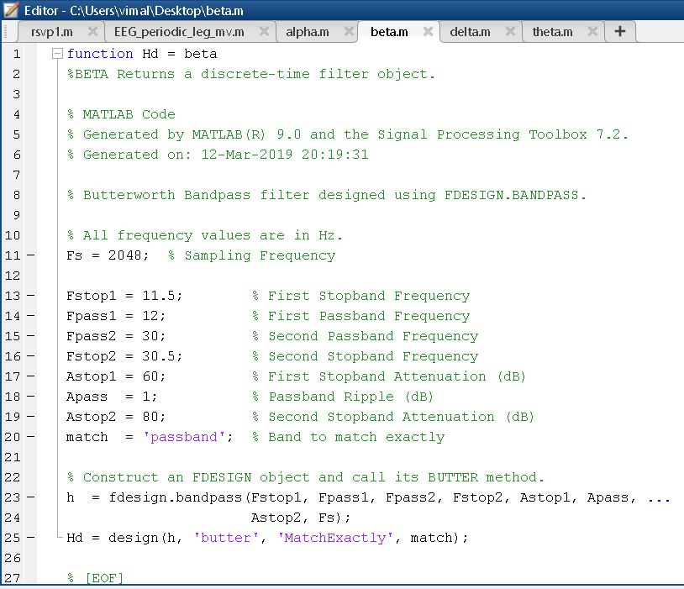
EEG Filter Design for Waves Classification

Slide 8
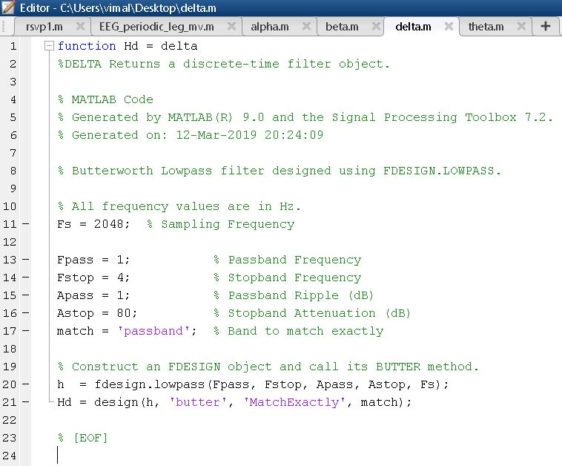
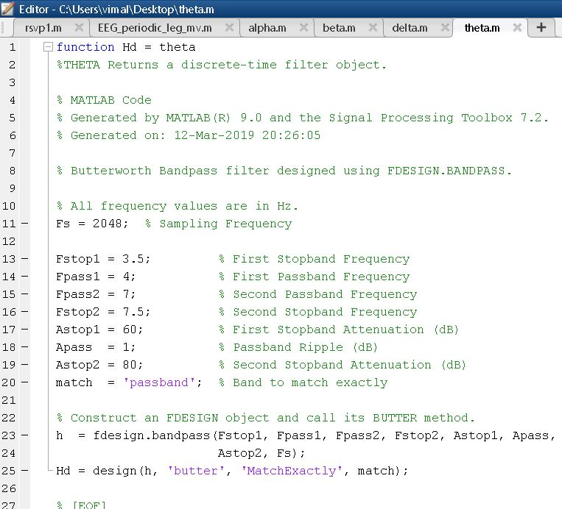
EEG Filter Design for Waves Classification

Slide 9
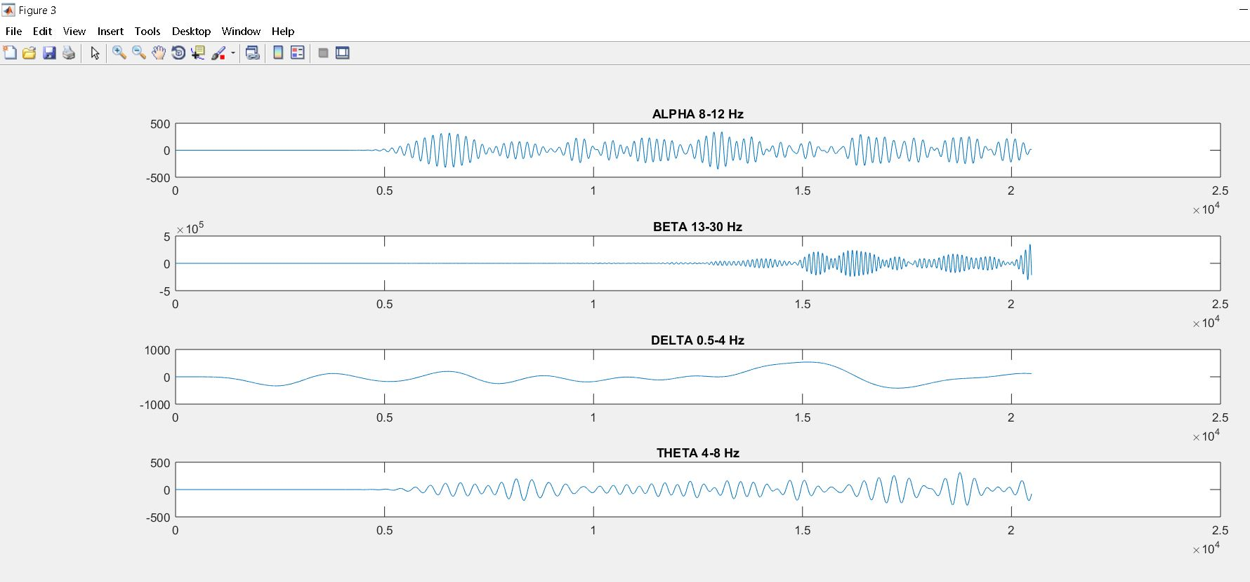
EEG Filter Application for Waves Classification
load ('C:\Users\vimal\Desktop\rsvp_10Hz_02a_edfm_P7');
figure;
EEGP07=val;
Hd = alpha;
a= filter(Hd,EEG_vimal);
subplot (5,1,1);
plot(a);title('ALPHA 8-12 Hz'); %ALPHA BAND PASS FILTER (8-12)
Hd = beta;
b= filter(Hd,EEG_vimal);
subplot (5,1,2);
plot(b);title('BETA 13-30 Hz'); %BETA BAND PASS FILTER (13-30)
Hd = delta;
d= filter(Hd,EEG_vimal);
subplot (5,1,3);
plot(d);title('DELTA 0.5-4 Hz'); %Delta LOW PASS filter (0.5-4)
Hd = theta;
t= filter(Hd,EEG_vimal);
subplot (5,1,4);
plot(t);title('THETA 4-8 Hz'); %THETA- BAND PASS FILTER (4-8)

Slide 10
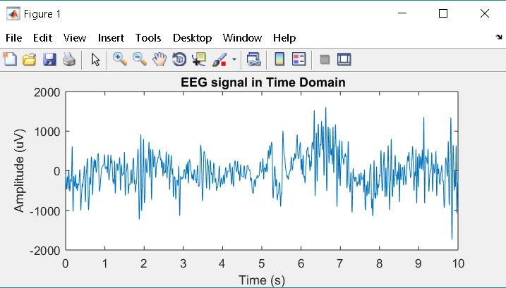
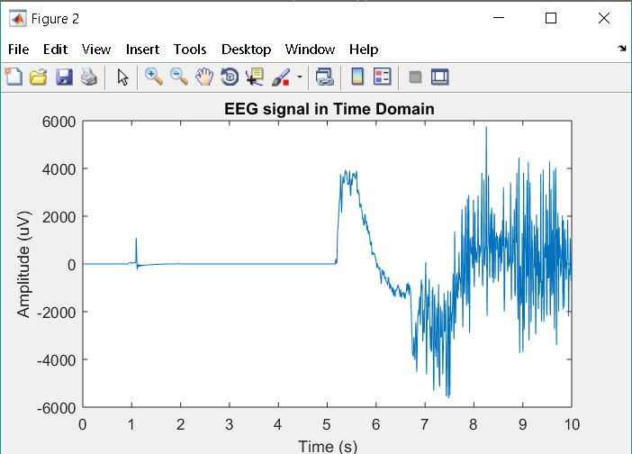
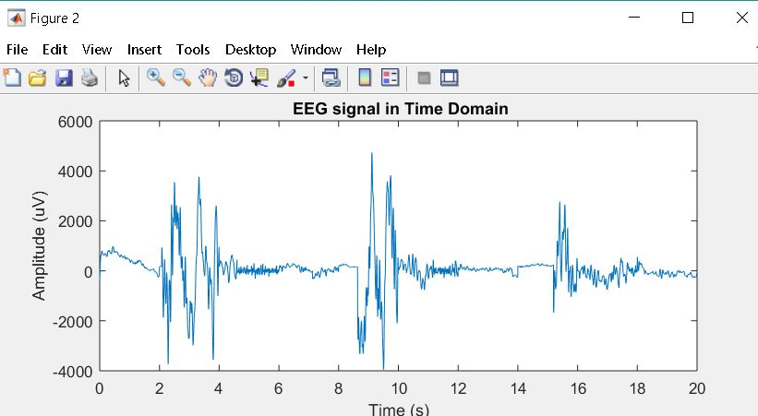
EEG Modelling and Feature Extraction.
EEG recordings from Physiobank Database:
Rapid Serial Visual Presentation (RSVP)
P7 channel, fs= 2048 Hz
The Cyclic Alternating Pattern (CAP) of EEG activity during sleep
Sleep-disordered breathing - sdb1 , fs=256Hz, fp2-fp4
Bruxism (condition in which you grind, gnash or clench your teeth)
– brux1, fs=256 Hz , fp2-fp4

Slide 11
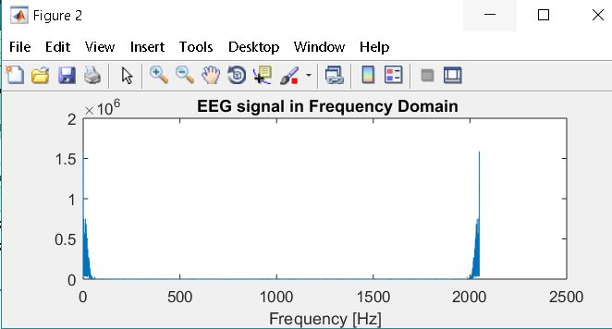
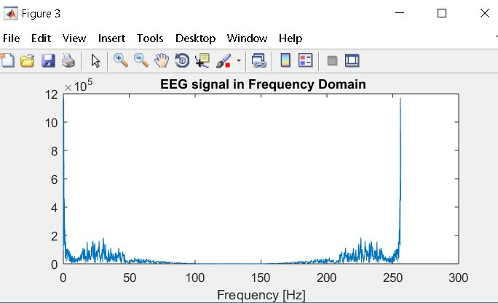
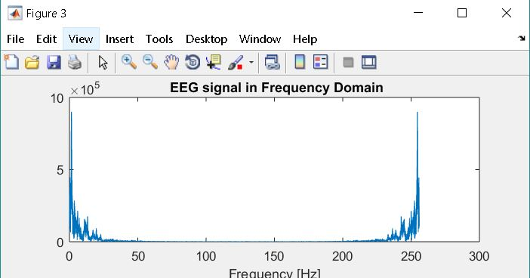
EEG Modelling and Feature Extraction.
EEG recordings from Physiobank Database:
Rapid Serial Visual Presentation (RSVP)
P7 channel, fs= 2048 Hz
The Cyclic Alternating Pattern (CAP) of EEG activity during sleep
Sleep-disordered breathing - sdb1 , fs=256Hz, fp2-fp4
Bruxism (condition in which you grind, gnash or clench your teeth)
– brux1, fs=256 Hz , fp2-fp4

Slide 12
EEG Modelling - Wave Analysis.
Rapid Serial Visual Presentation (RSVP)
P7 channel, fs= 2048 Hz

Slide 13
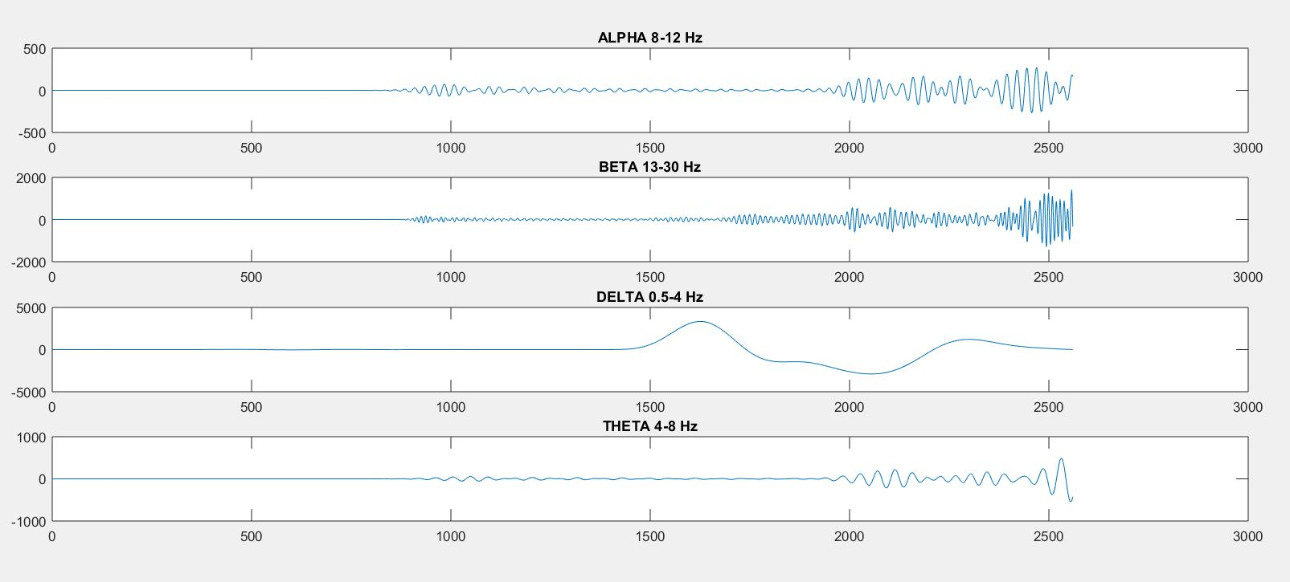
EEG Modelling and Wave Analysis.
Sleep-disordered breathing - sdb1 , fs=256Hz, fp2-fp4

Slide 14
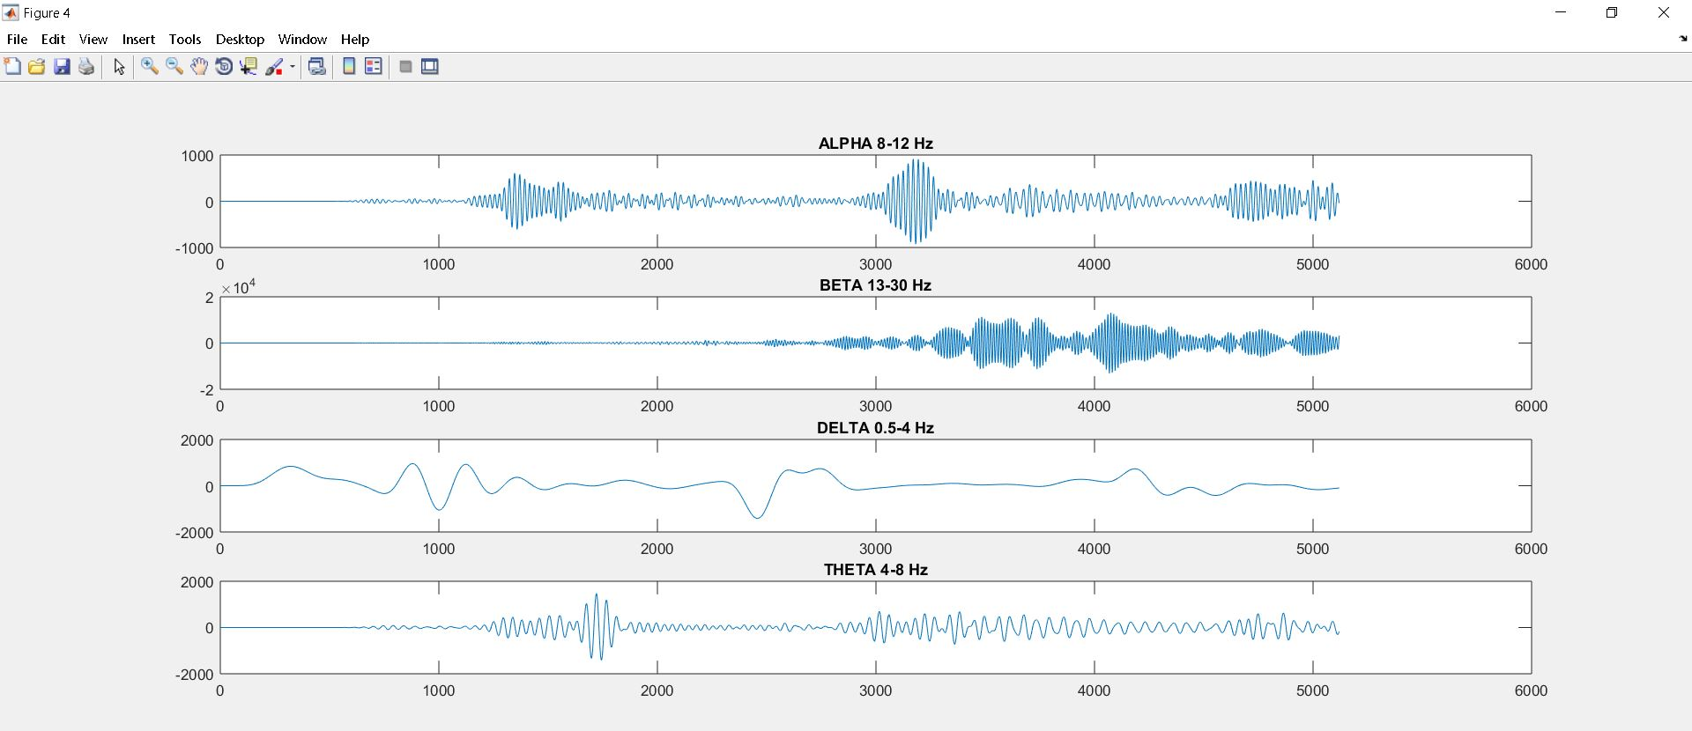
EEG Modelling and Wave Analysis.
Bruxism (condition in which you grind, gnash or clench your teeth)
– brux1, fs=256 Hz , fp2-fp4

Slide 15
EEG Modelling and Wave Analysis.
Bruxism (condition in which you grind, gnash or clench your teeth)
– brux1, fs=256 Hz , fp2-fp4

Slide 16
EEG Advanced Feature Extraction.
WFDB tool - Software for viewing, analyzing, and creating recordings of physiologic signals
EEGlab - for processing data from electroencephalography (EEG), magnetoencephalography (MEG), and other electrophysiological signals.

Slide 17
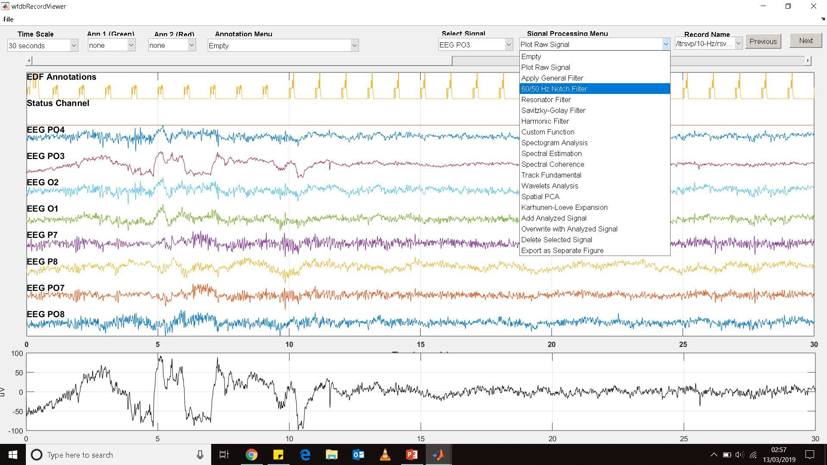
EEG Advanced Feature Extraction.

Slide 18
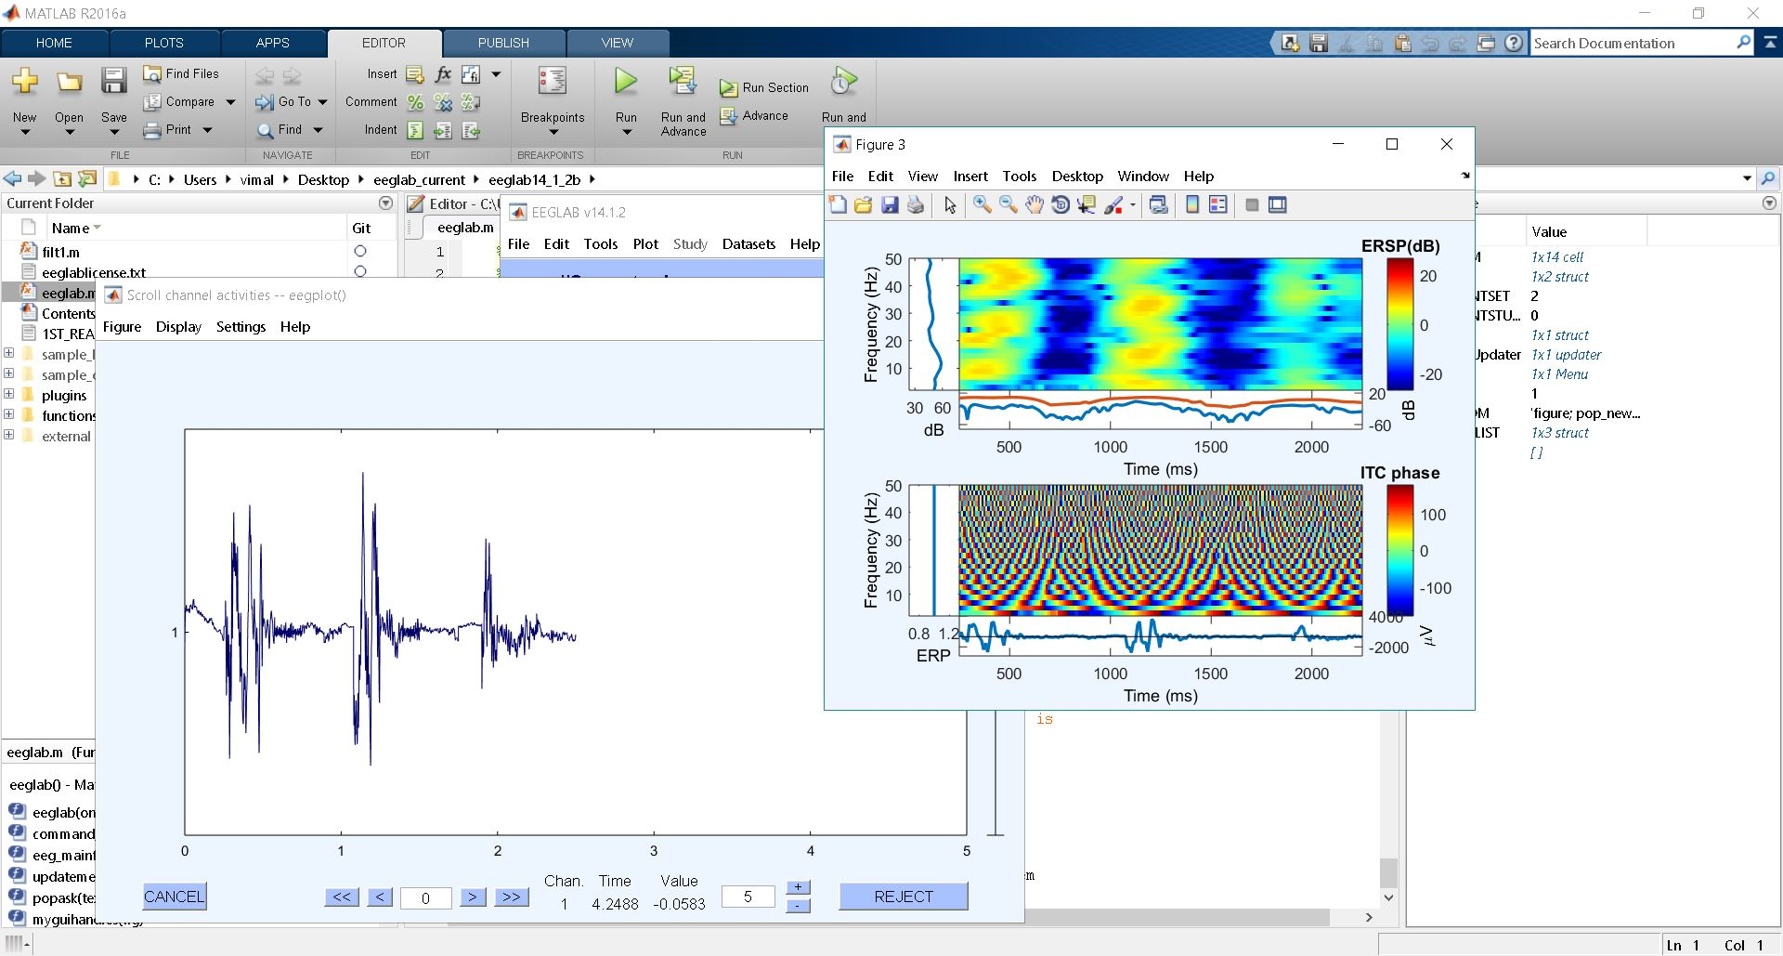
EEG Advanced Feature Extraction.

Slide 19
Refrences.
[1]J. Kumar and P. Bhuvaneswari, "Analysis of Electroencephalography (EEG) Signals and Its Categorization–A Study", Procedia Engineering, vol. 38, pp. 2525-2536, 2012. Available: 10.1016/j.proeng.2012.06.298.
[2]A. Tandle, N. Jog, P. D'cunha and M. Chheta, "Classification of Artefacts in EEG Signal Recordings and EOG Artefact Removal using EOG Subtraction", Communications on Applied Electronics, vol. 4, no. 1, pp. 12-19, 2016. Available: 10.5120/cae2016651997.
[3]https://physionet.org/physiobank/database/eegmat/
[4]https://www.mathworks.com/

Slide 20
Thank You

